Slide 1


Spain Electricity Shortfall Challenge (EDA)
TEAM 16

Slide 2
Team MEMBERS
VUYISILE NGOBENI
RELOEF MIKATEKO KHOZA
NHLANHLA PATRIC HLENGWANE
SILINDILE NQOBILE NCUBE

Slide 3

INTRODUCTION
Spain is the sixth-largest energy consumer in Europe, with approximately 47.1 million people.
Moreover, each citizen relies on energy for their activities.
There has been an increase in the generation of power over the years Including energy generated by means of fossil fuels and various renewable.
This presentation is based on the model that we have developed to help the government of Spain to predict the energy shortfalls.

Slide 4

DEFINING THE PROBLEM STATEMENT
Building a model that will help the government of Spain to accurately predict the three hourly shortfalls of the energy generated by means of fossil fuels and various renewable sources - for the country of Spain.
The daily shortfall, which will be referred to as the target variable, will be modelled as a function of various city-specific weather features such as `pressure`, `wind speed`, `humidity.

Slide 5

THE PROJECT LIFE CYCLE
1.Loading data
2. Exploratory Data Analysis (EDA)
3.Data Engineering
4. Modeling
5. Model Performance

Slide 6
1. LOADING DATA
The data required to train and test the model was loaded from csv files to the pandas data frame in order to manipulate the data using python libraries.

Slide 7
2. EXPLORATORY DATA ANALYSIS
Is an approach used by data .We Firstly looked at the description
scientists to analyze and investigate of the given data in the form of the five
data sets and summarize their main number summary, mean, count and
features, often employing data standard deviation.
visualization methods.
A table shown below shows that some
Columns in a table have values that are
likely to be the same such as the Madrid_temp
_min and the Madrid_temp column.

Slide 8
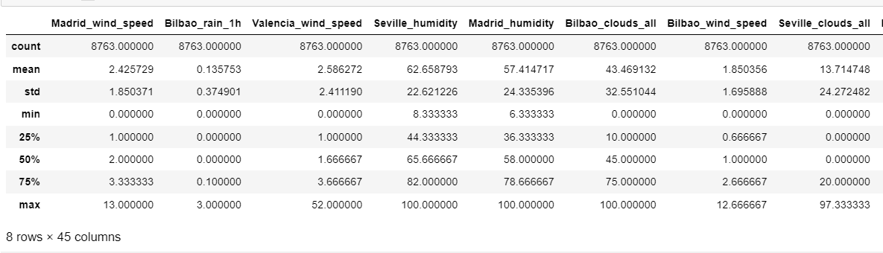
From this we conclude that we have data redundancy in our given data.

Slide 9
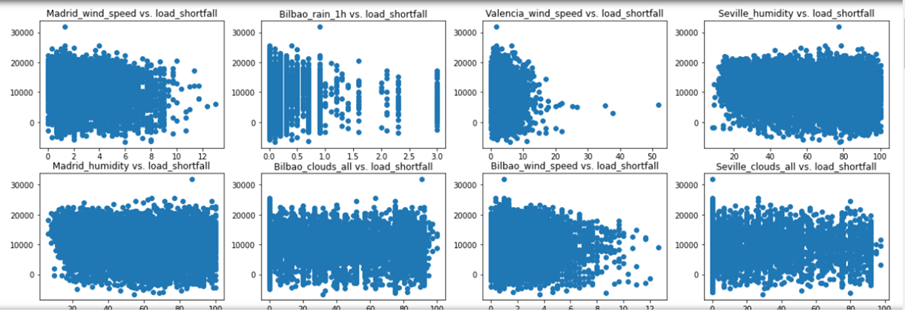
The above scatter plots exhibit relationship between all Spaniard cities weather features against load shortfall. This scatter plot is done to preview relevant correlations and the distribution of data.

Slide 10
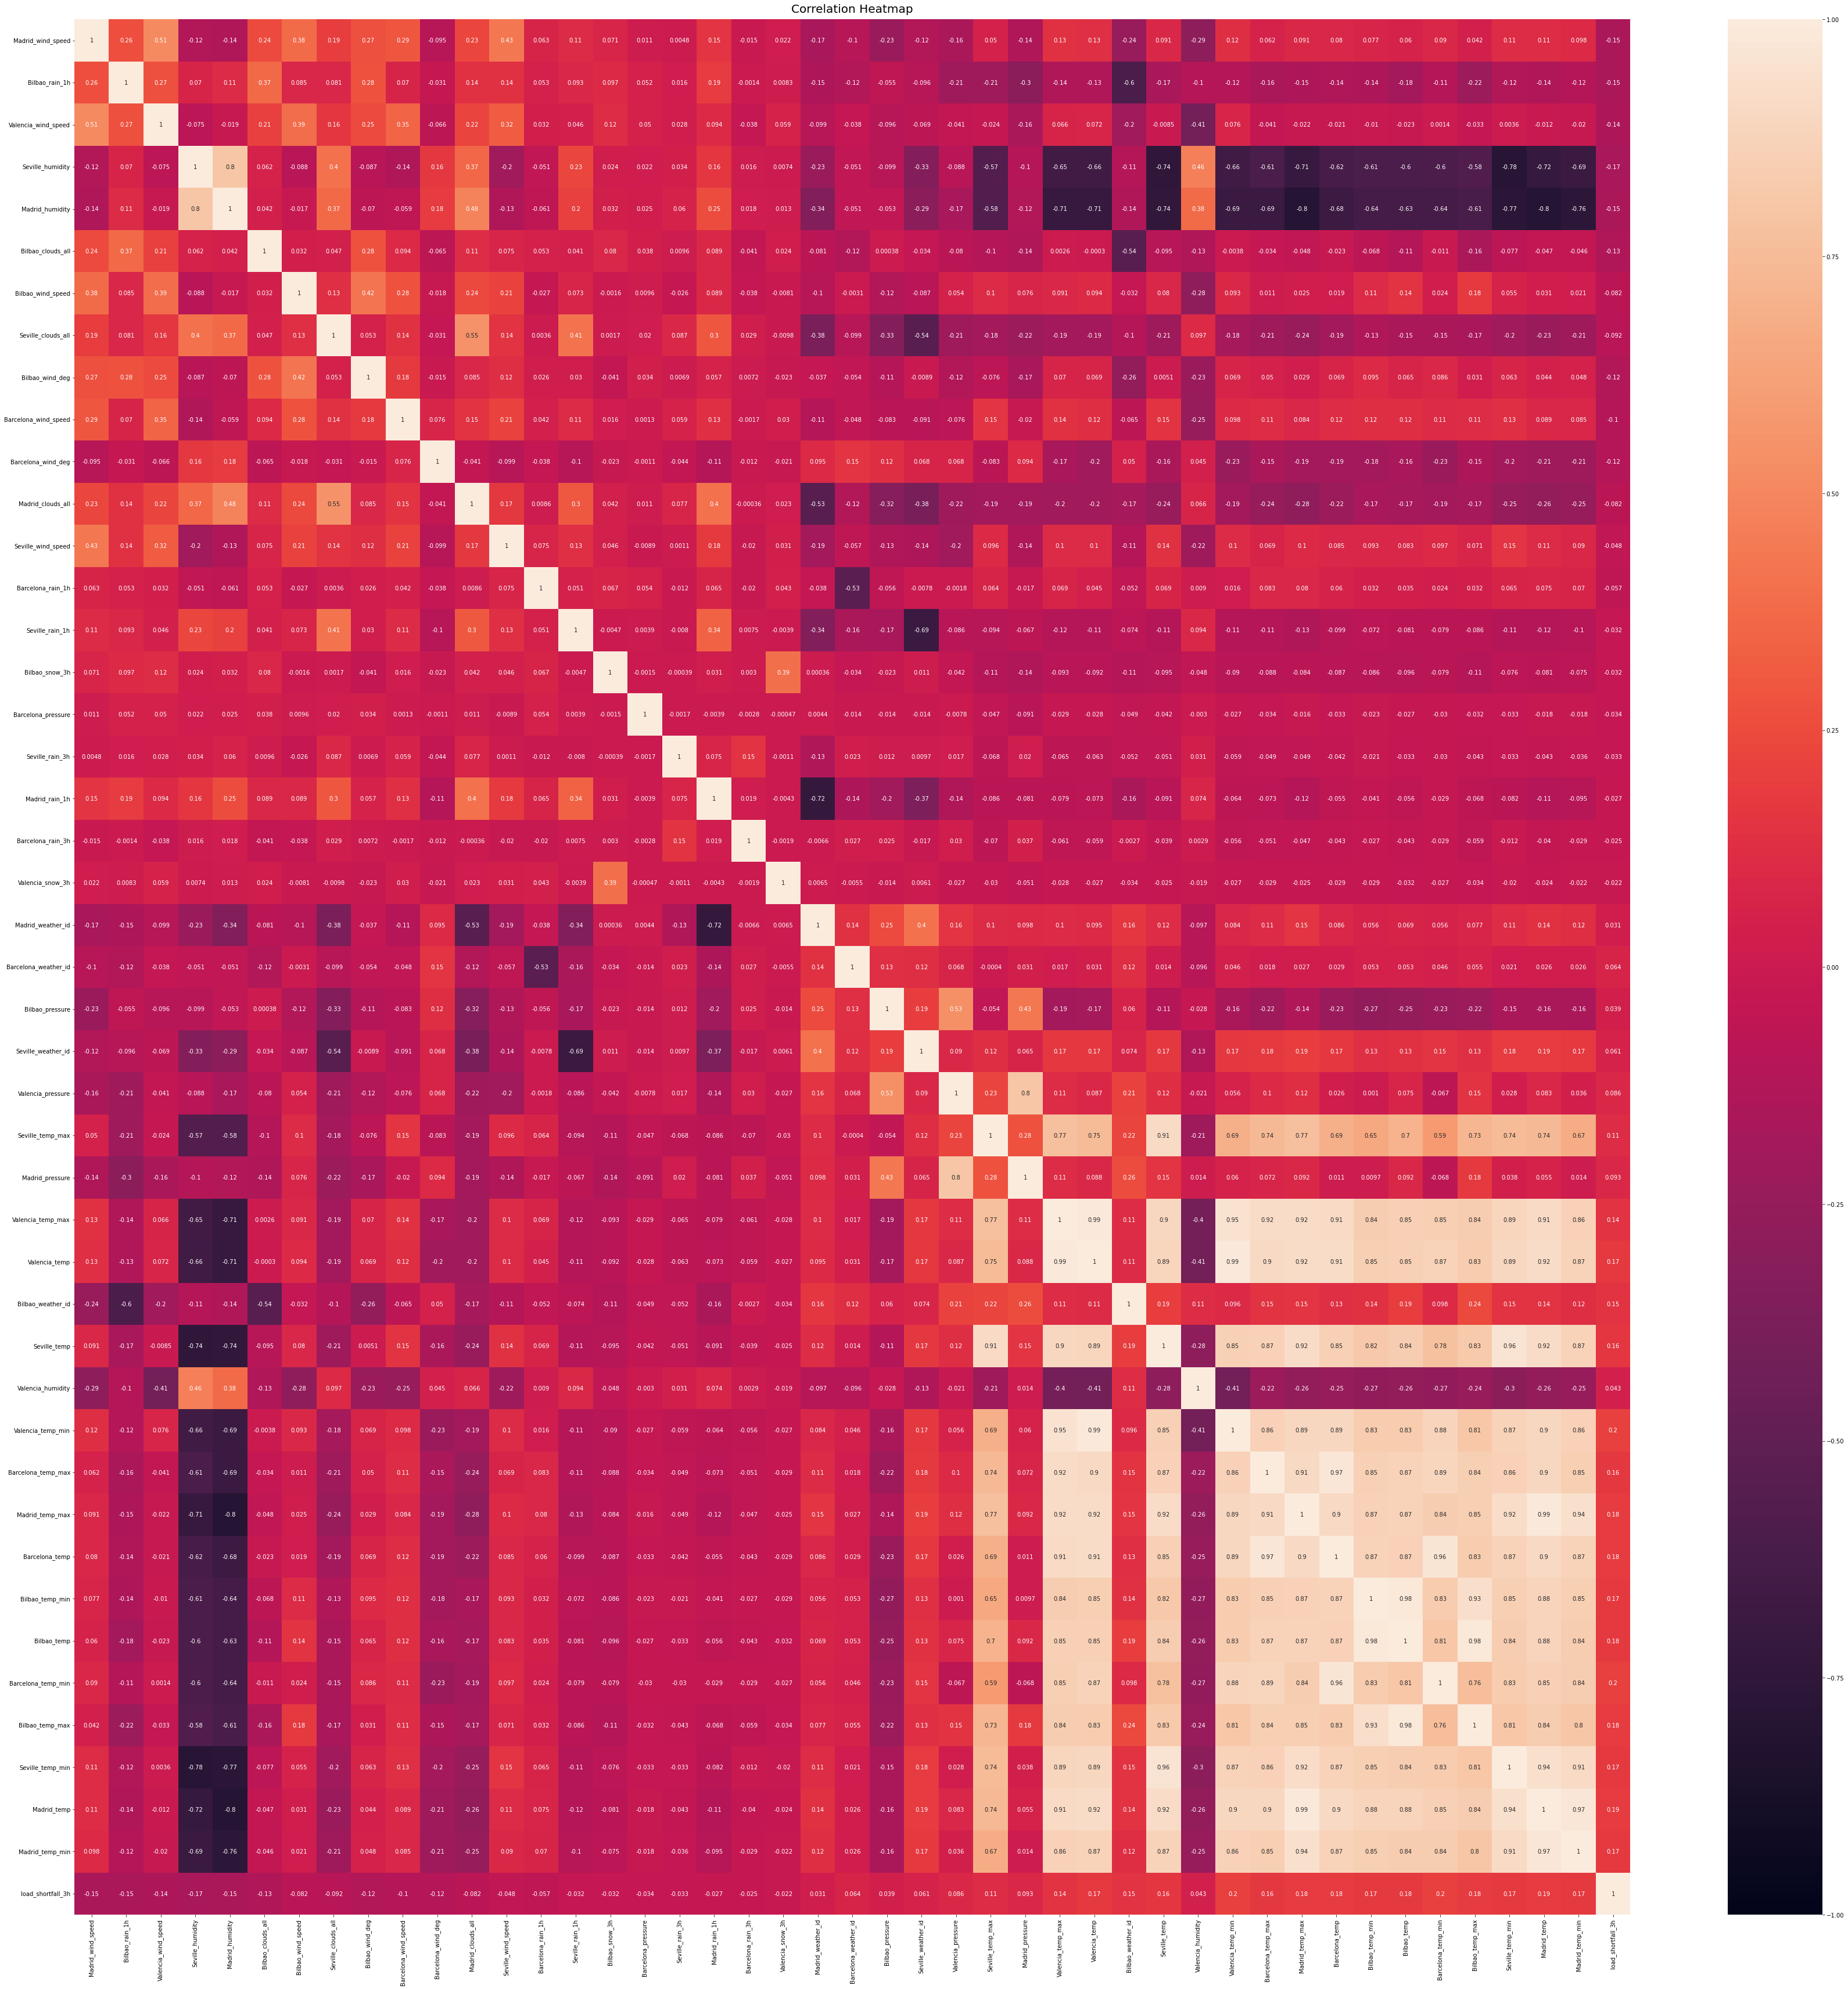
The heat map here is plotted to further investigate strong correlations of weather features against load shortfall for all the Spaniard cities.

Slide 11
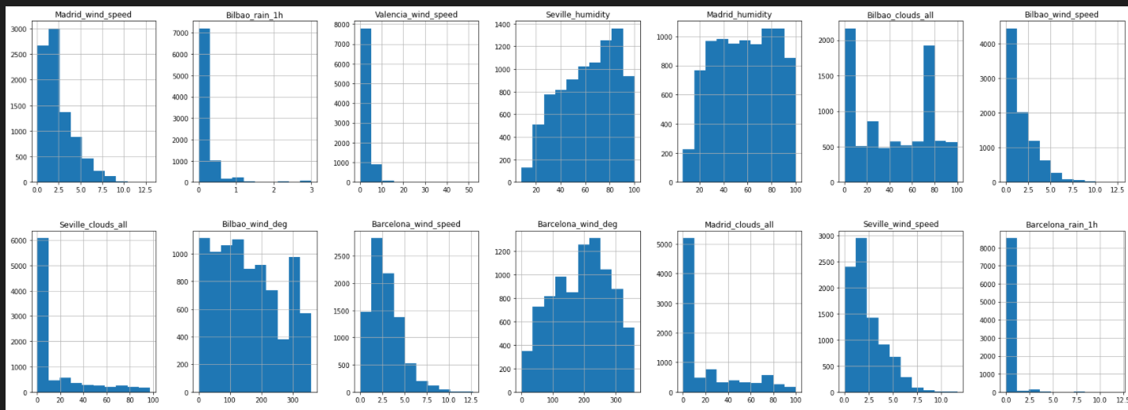
To check the distribution of the features in the given dataset we use the histogram as shown in the figure below. from the figure below, we can see that our data is not in a good format because most of the given features use a different scale or the data is not standardized. The normal distribution of the load_shortfall_3h column show that the load shortfall likely to be to range between 9000 to 13000 because its probability is higher at that range.

Slide 12
3. DATA ENGINEERING
Check for percentage of nulls in all columns for the train and test data respectively
Valencia pressure is the only column with null value entries where the null percentage is 23.6% and 15.55% for train and test data respectively. The percentage is low for us to consider deleting/dropping the column thus replacing/imputing the nulls with an appropriate statistic should be explored.
The mean, median and mode values are approximately the same for both sets of data hence we chose to replace the nulls with mode since this indicate the most common pressure value on the respective data frame columns.
we check the data type of all columns in our data in order to make sure that all variables are stored in the correct data type

Slide 13
unfortunately, time, Valencia_wind_deg and Seville pressure columns are object variables, and they cannot be used to build regression models.
explore all the object columns and we found that both Seville_pressure and Valencia_wind_deg columns consist of categorical data. However, the data inside the columns categorize the pressure and wind degree in different levels in a form of a string or text.
The feature Seville_pressure and Valencia_wind_deg are presented categorically by a string that has a number associated with it; as such we manipulated the features to be represented by the dummy variable/number(float) associated with that string category.

Slide 14
After creating dummy variables for the Valencia_wind_deg and Seville_pressure columns, we saw that they are now converted to float64 data type. which means that they are now containing numbers instead of string and can now be used to build any linear regression model.
However, the time column is of the object data type. to fix that problem, we convert the data type of the time column to datetime data type in order to ensure that all values within the time column are stored in the form of datetime. furthermore, from the time column we extract year, month, day and hour columns. this will allow the model to consider year, month, day and hour when making predictions.

Slide 15
4. MODELING
This section involves all the necessary processes required to create our predictive models in order to predict the load shortfall for the spain government.
split training data frame into train data and test data (this done to train and evaluate the performance of model on seen and unseen data. The main reason for not using the given test data for testing our model is because it does not have the values of the response variable, so we are forced to split the training data into train and test data.)
create five predictive models: Linear regression model, Ridge model, Lasso model, Decision tree and the random forest.

Slide 16
Standardized the preprocessed data to achieve consistency by ensuring each data type has the same scale, content and format.
Train the models using the train data created from the training data set.
Make predictions for the seen data and unseen data using all the created models

Slide 17
5. MODEL PERFOMANCE
In this section we evaluate the performance of our models and select the best model performing model.
For all model in order to evaluate their performance the dictionary containing the calculated RMSE was created.
The Random forest model contains less RMSE compared to other models, so it can be concluded that it has higher prediction accuracy compared to other models. For this reason we can conclude that the random forest model is the best model compared to other models developed in this project.

Slide 18
6. CONCLUSION
In conclusion the random forest model is the suitable model that can help the government of Spain with the prediction of a 3 hourly energy Shortfalls. The conclusion was drawn from comparing the created models.

